Slide 1
Version Control – using git with MATLAB
Dr Louise Brown

Slide 2

What is Version Control? Why should I use it?
Helps us to keep track of what we did and when.
Even if you are not collaborating with other people it is better than this:
“Piled Higher and Deeper” by Jorge Cham, http://www.phdcomics.com

Slide 3

What is Version Control?
‘… a system that records changes to a file or set of files over time so that you can recall specific versions later’ ¹
Pro Git book, available online (free!)
¹ https://git-scm.com/book/en/v2/

Slide 4
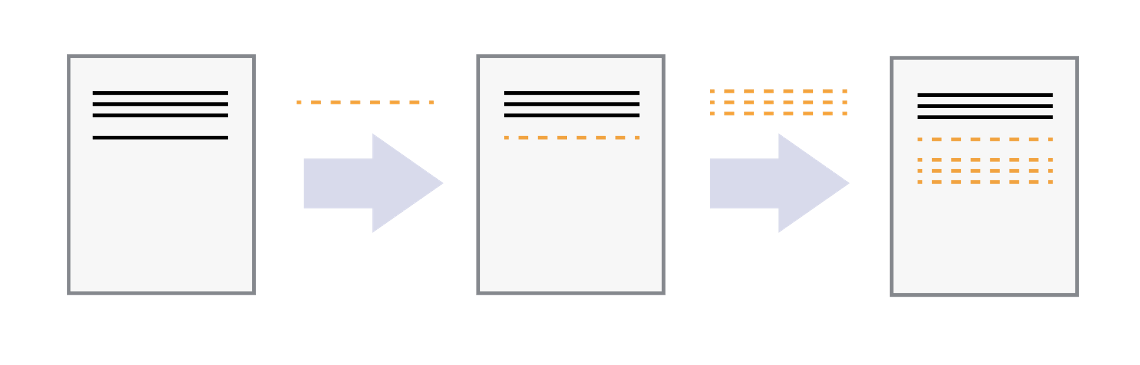
Save incremental changes to a file
Version control systems start with a base version
Changes are recorded at each step
It is possible to ‘rewind’ to a previous version

Slide 5
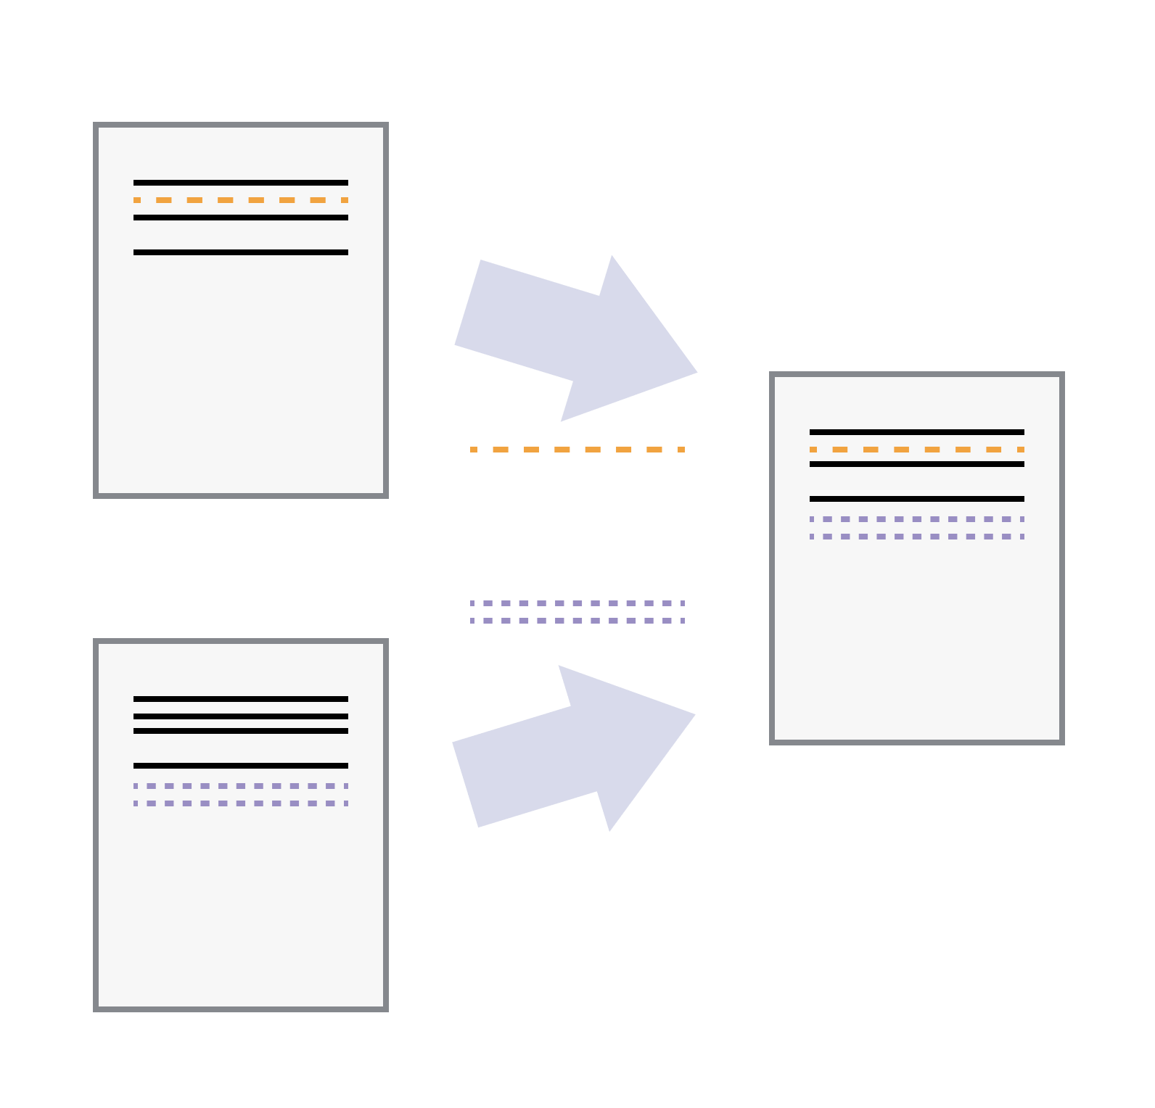
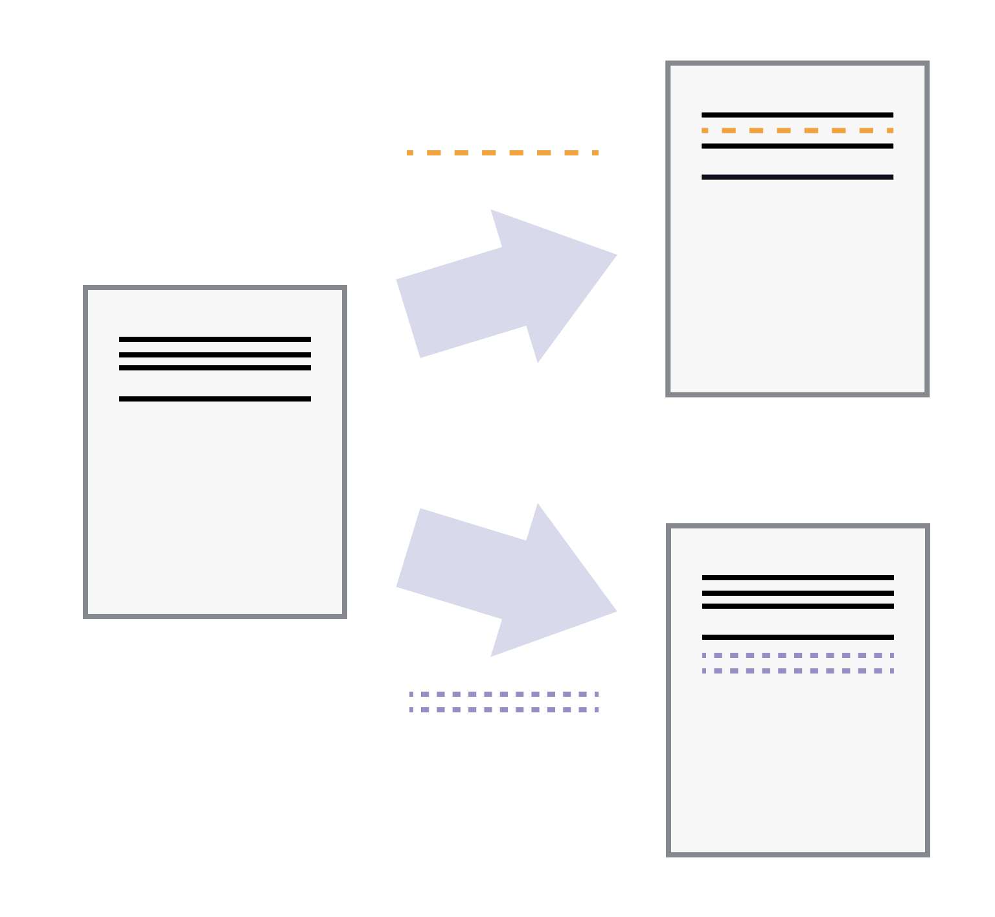
Multiple users can safely work on one file
Multiple users can make independent changes to the same document
Unless multiple users make changes to the same section of the document - a conflict - you can incorporate two sets of changes into the same base document.

Slide 6
Version control systems
A version control system is a tool that keeps track of these changes for us, effectively creating different versions of our files.
It allows us to decide which changes will be made to the next version (each record of these changes is called a commit), and keeps useful metadata about them.
The complete history of commits for a particular project and their metadata make up a repository.
Repositories can be kept in sync across different computers, facilitating collaboration among different people.

Slide 7
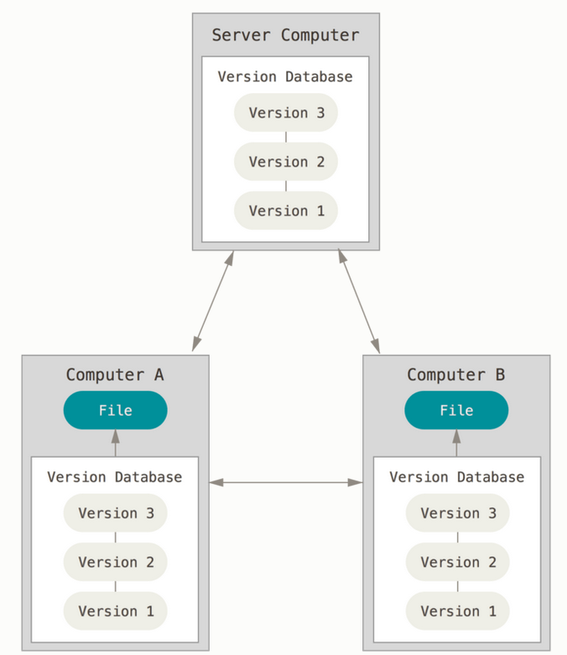
Distributed Version Control
We will be using Git which is a ‘distributed version control’ system
A distributed version control system replicates the whole repository on each machine.
Work can continue if the server is offline or if you have no internet access.
https://git-scm.com/book/en/v2/Getting-Started-About-Version-Control

Slide 8
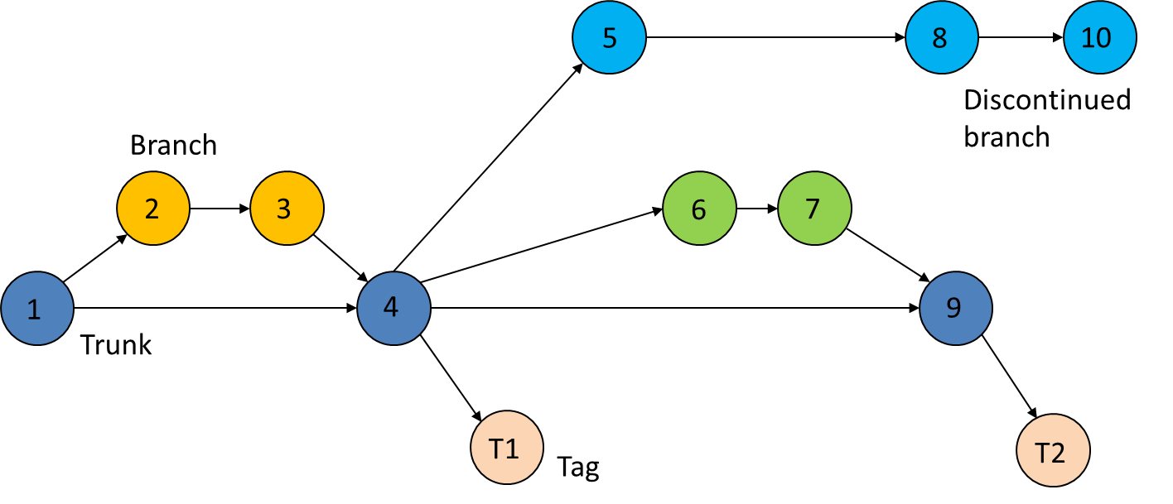
Git Workflow
Tags can correspond to code producing results for research papers

Slide 9

Installing Git
git should already be installed on the computer lab computers
To install on your own computer, visit https://git-scm.com/downloads
When using on a computer for the first time, the following configuration is needed
Set up name and email address
Open git bash command window using the icon on the desktop
Type:
git config --global user.name “Your name”
git config --global user.email Your@email.address

Slide 10
Where does Git store information?
The command git init will create a repository in the folder where the command was executed
This creates a hidden subfolder called .git
This contains all the information about the project, including files and sub-folders.
Do not manually change anything in this folder – the Git commands executed will do this for you
We will be using the MATLAB – GitHub – Git integration to create repositories

Slide 11
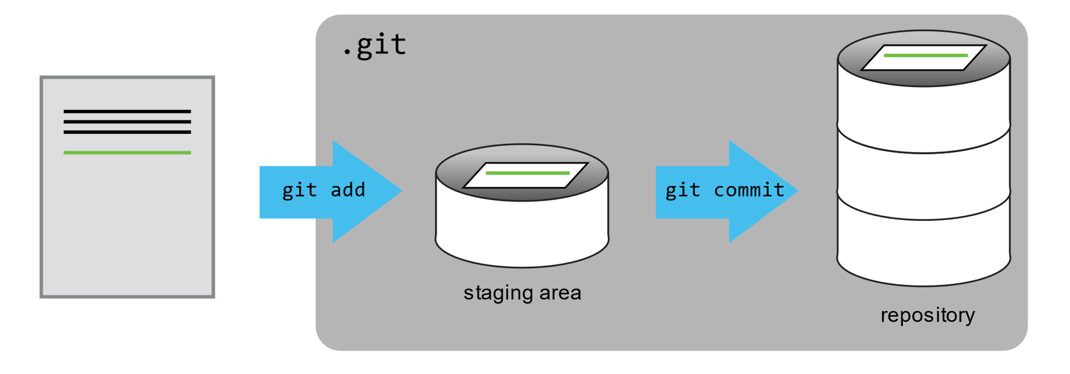
Tracking Changes - Git Workflow
Local
Working folder
Staging area
Local repo
git add
git commit
git checkout
git merge
Save one or more changes to go into the ‘snapshot’
Save the snapshot to the repository

Slide 12
Git Workflow – with remote
Local
Remote
e.g. GitHub
Working folder
Staging area
Local repo
Remote repo
git add
git commit
git push
git pull
git checkout
git merge

Slide 13
Git Workflow – collaborating with other users
Local
Remote
e.g. GitHub
Working folder
Staging area
Local repo
Remote repo
git add
Pull request
Fork
git commit
git push
Another GitHub User’s Repository
git pull
git checkout
git merge

Slide 14

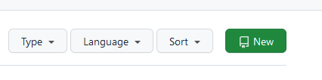
Integrate MATLAB and Git – Create a new repo
First, create a new repository in GitHub:
From your Home page, select the Repositories tab
Then select the ‘New’ button in the top right corner

Slide 15
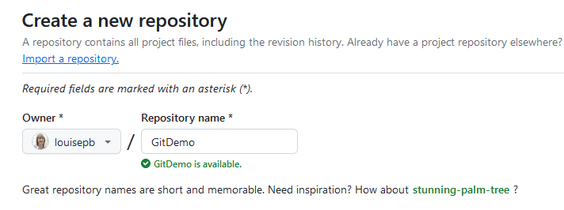
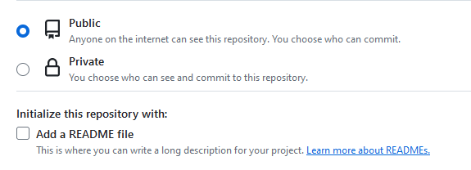

Create a repo on GitHub
Select a name for the repo
Decide whether it will be public or private (probably private if it’s for your coursework!)
Add a README file if desired
And finally, select the button at the bottom to create the repo

Slide 16
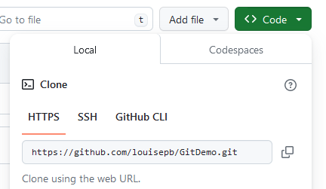
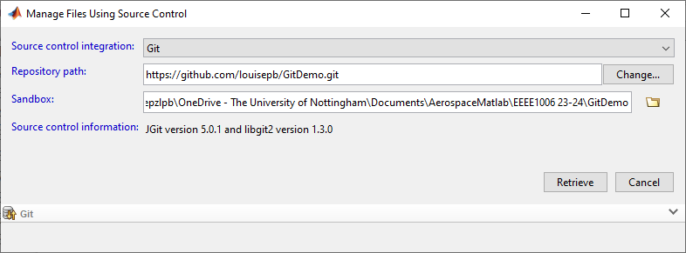
Clone your GitHub repo
Then create a clone of the code on your local drive
Select the Code button and copy the address
Go back to MATLAB
Right click in Current Folder Window
Select Source Control -> Manage Files…
Select an empty folder (ideally with the same name as your repo) to clone into
Create a new folder if necessary

Slide 17
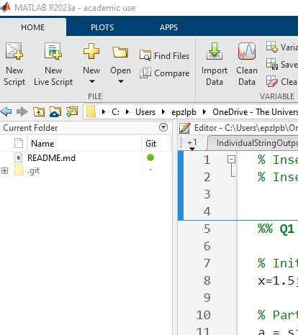
View repo in MATLAB
The cloned repo is now visible in MATLAB
The README file is there
Note the .git folder (don’t do anything to this!)
You are now ready to add files and keep a record of changes using Git !

Slide 18
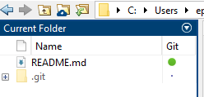
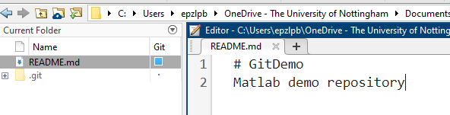
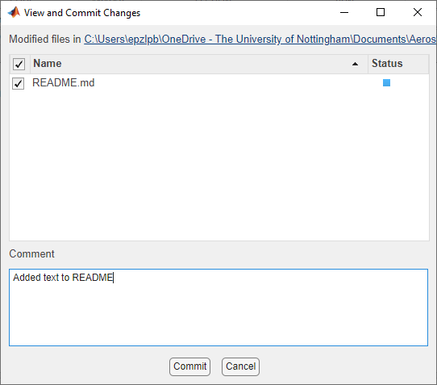
Saving changes to a file in the local repo
The README file is up-to-date (shown by the green dot)
Make a change to the file and save. The blue square shows that there is an unstaged change
Right click in the Current Folder window and select ‘Source Control -> View and Commit Changes…’
Add a commit message in the dialog
Note that the MATLAB integration combines the staging (add) and commit instructions
Select ‘Commit’
The file will now show as up-to-date again
(Note that this has not yet been synced with the remote repo

Slide 19
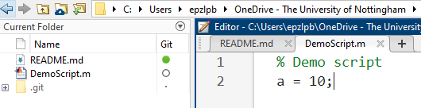
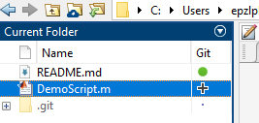
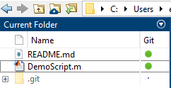
Adding new files to the local repo
A new file, DemoScript.m, is added to the folder. The empty circle shows that this file is not tracked in the repo
Right click on the filename and select ‘Source Control -> Add to Git’
A + sign now indicates that the file has been added to the repo
The file can now be committed to the repo as described in the previous slide
The green dot shows that this file is now saved in the repo

Slide 20
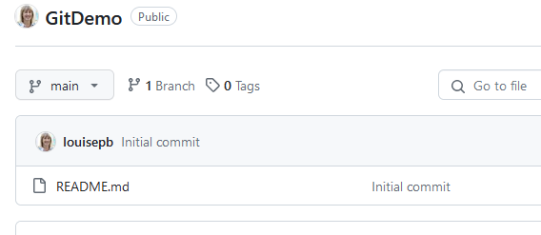
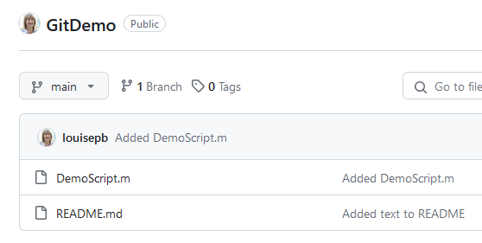
Saving to the remote repo
The files are now safely committed in the local repo but have not yet been backed up to the remote one
GitHub still only shows the initial creation of the README file
Right click in the Current Folder window and select ‘Source Control -> Push
You may be asked to verify your GitHub credentials at this point
Refresh the GitHub page and the new files will be shown
The local and remote repos are now synced

Slide 21
Content adapted from Software Carpentry material
Some of the content and figures in this presentation are adapted from the Software Carpentry Version Control with Git: Beginner lesson, made available under the Creative Commons Attribution license
Copyright © 2018–2022 The Carpentries Copyright © 2016–2018 Software Carpentry Foundation

